Slide 1
Tooling
And installers….

Slide 2

Notes:
Set up Azure account

Slide 3

https://visualstudio.microsoft.com/vs/
Notes:
Install Visual Studio 2019

Slide 4
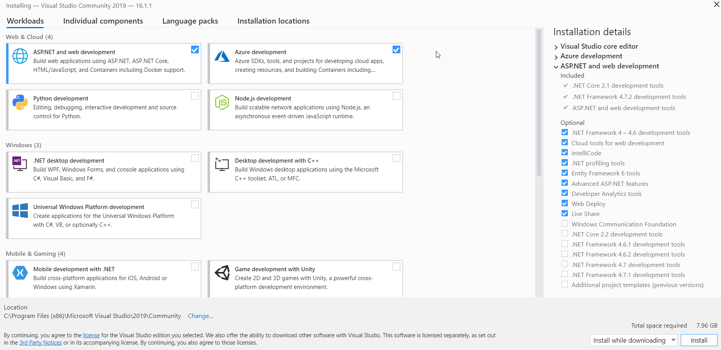
Notes:
VS install screens
- Azure SDK

Slide 5
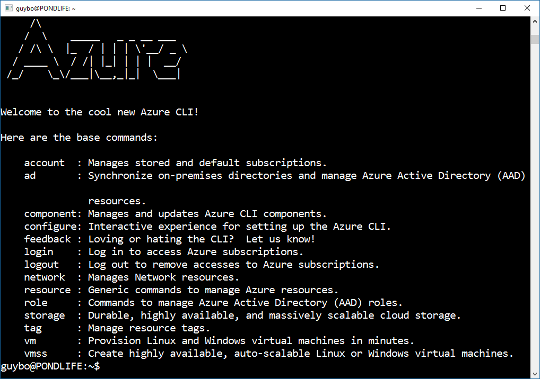
https://docs.microsoft.com/en-us/cli/azure/install-azure-cli?view=azure-cli-latest

Slide 6
Command Structure
az
<service>
<action>
<parameters>
<global arg>
az
vm
create
--name --resource-group --location
az
vm
list
-g
--output
az vm create -n ACGVm -g ACGResourceGroup --image UbuntuLTS

Slide 7
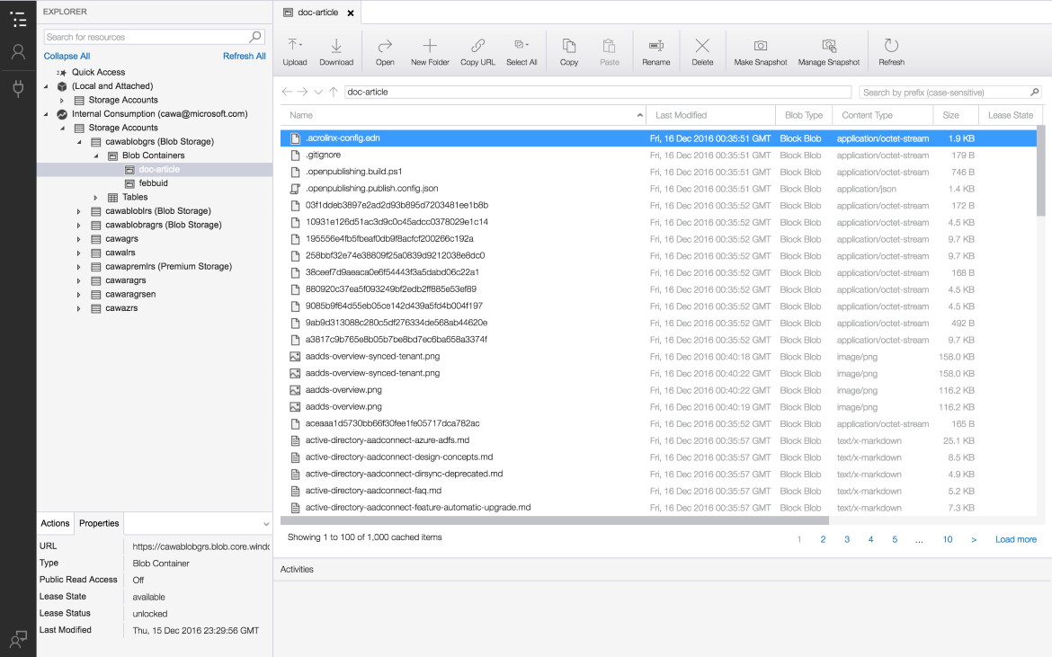
Storage Explorer
https://azure.microsoft.com/en-au/features/storage-explorer/

